Slide 1
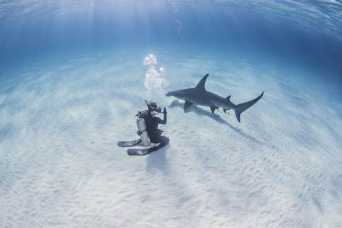
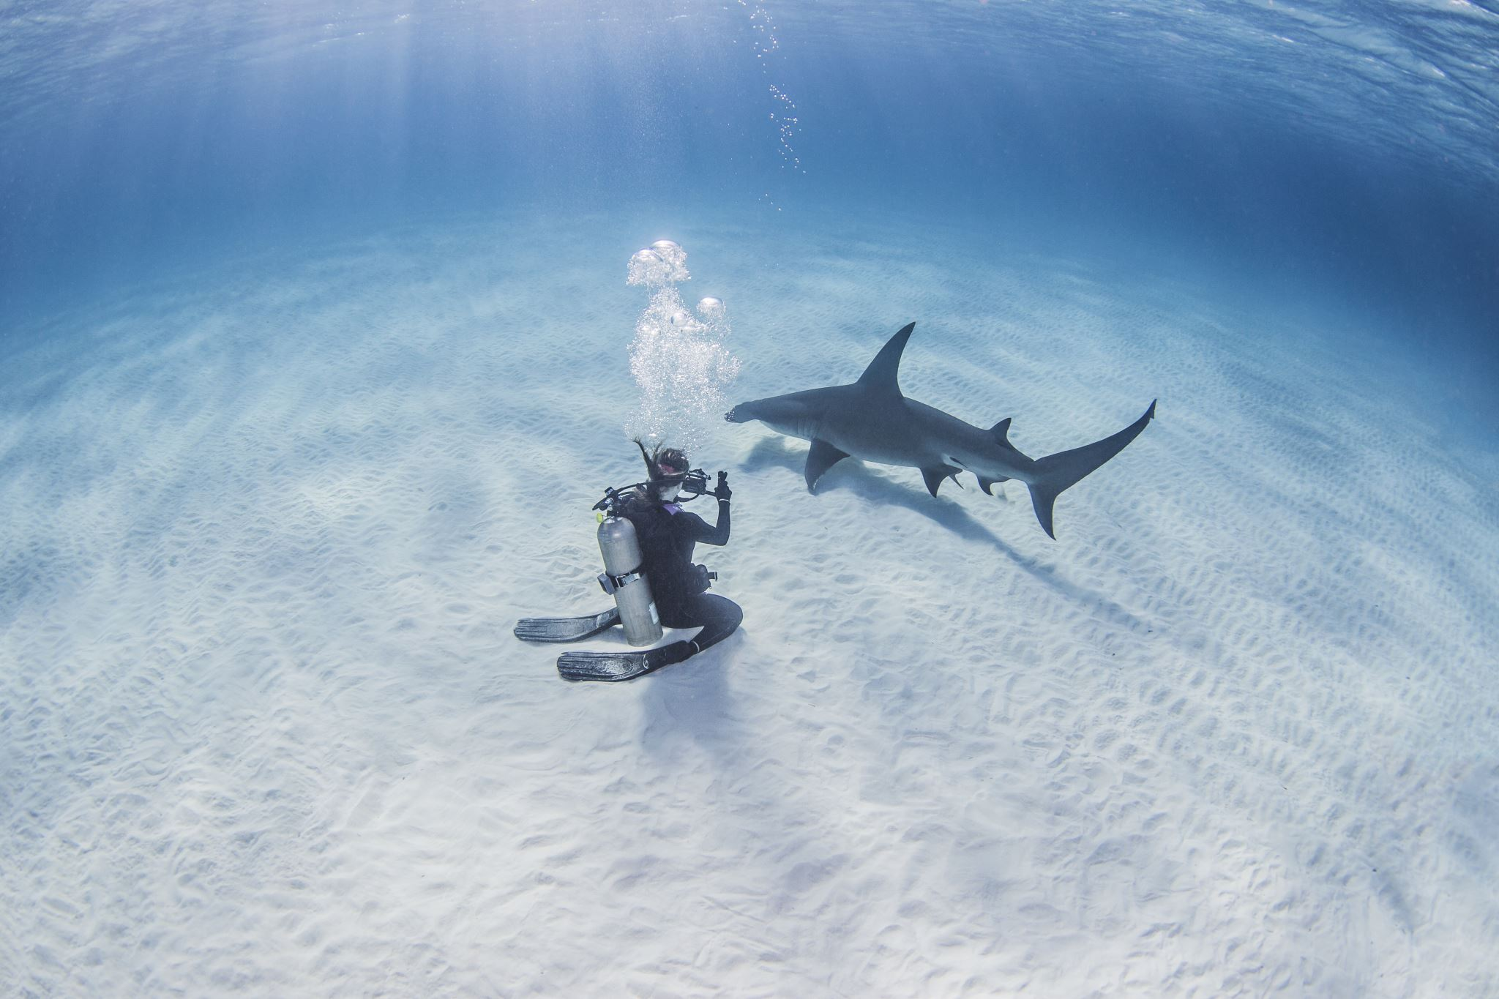
Shark Quest

Slide 2
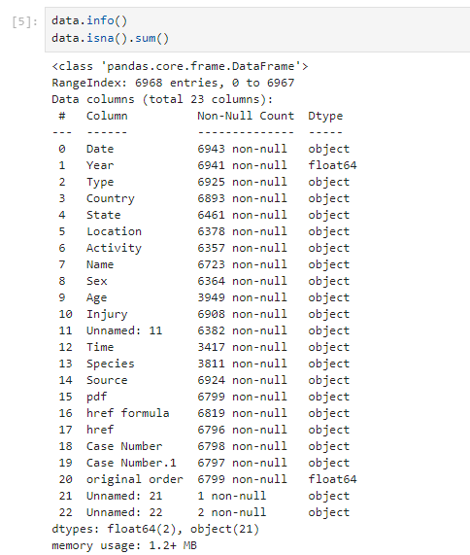
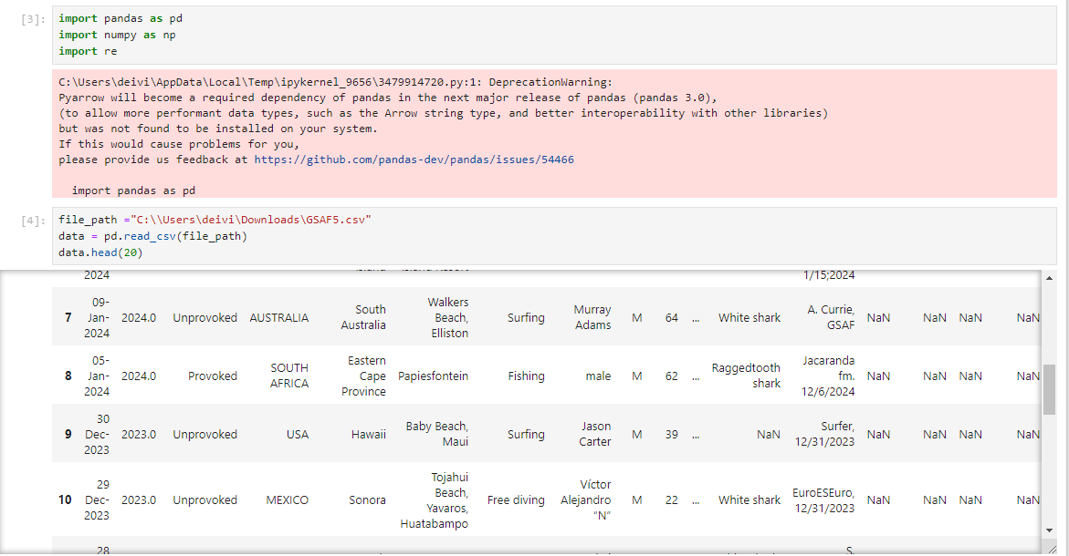
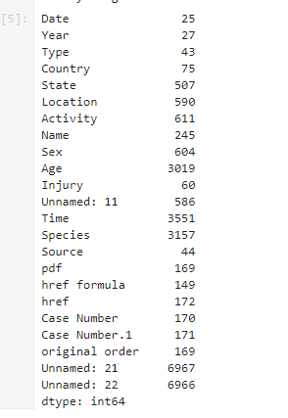
Data Read and Head

Slide 3
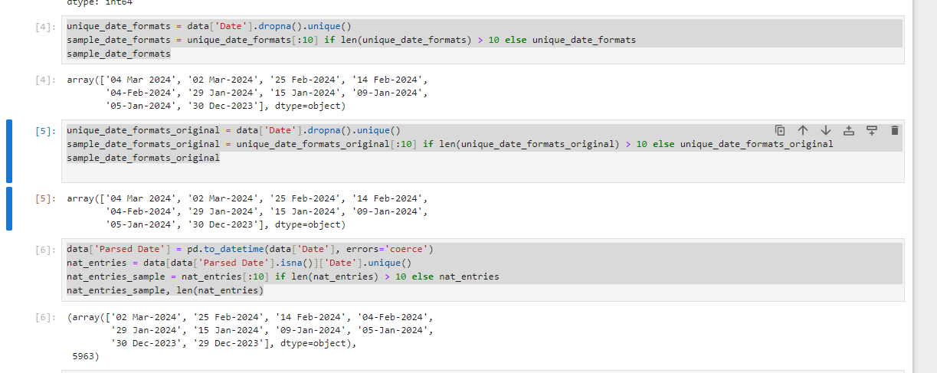
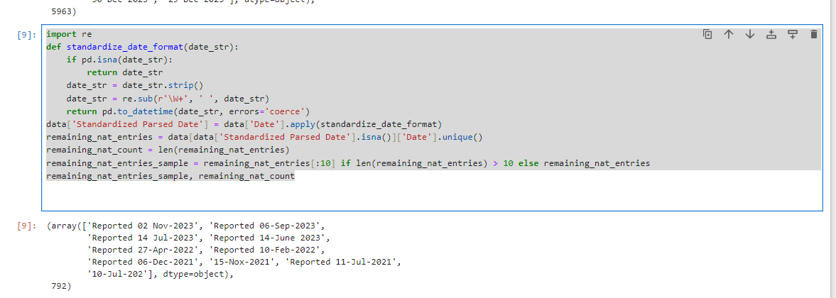
Date

Slide 4

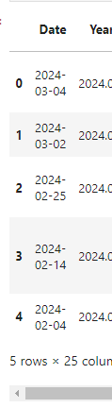
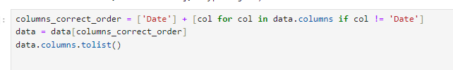
Date

Slide 5
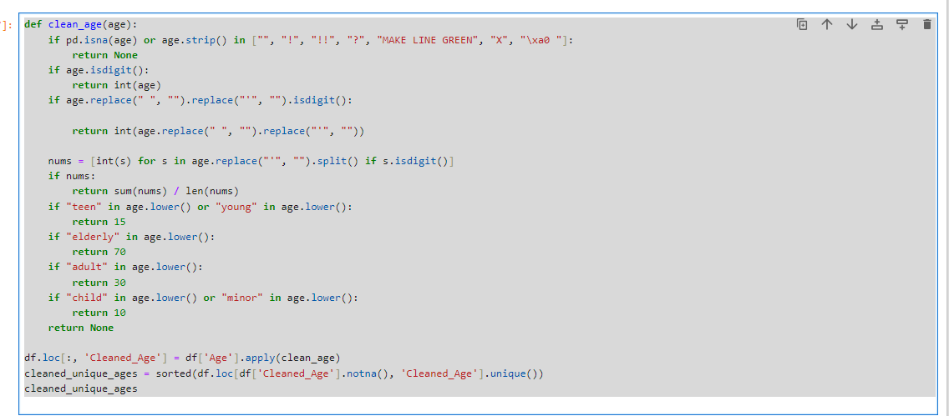
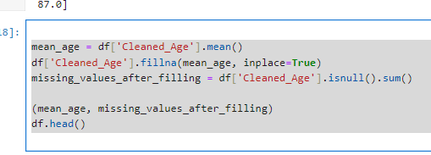
Age

Slide 6
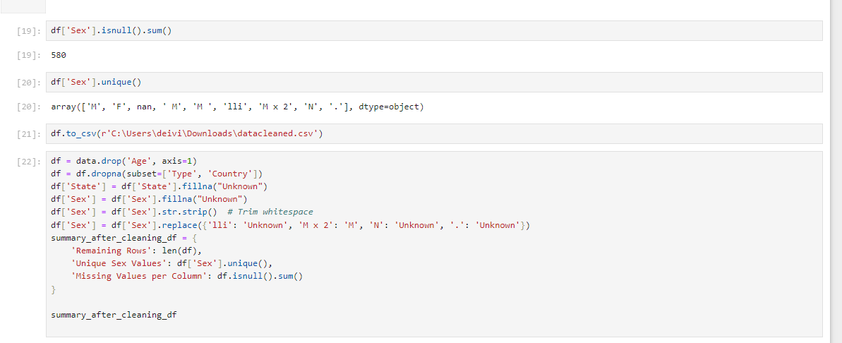
Sex

Slide 7
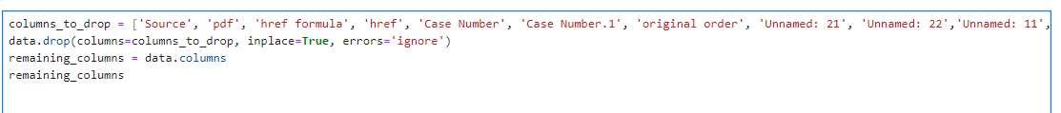
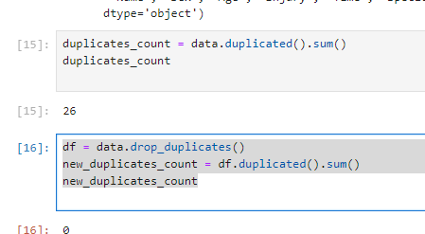
Drop
Time
Species
Source,
Pdf
, href
formula
, href,
Case Number
, Case Number.1
, original order
, Unnamed: 21,
Unnamed: 22,
Unnamed: 11

Slide 8
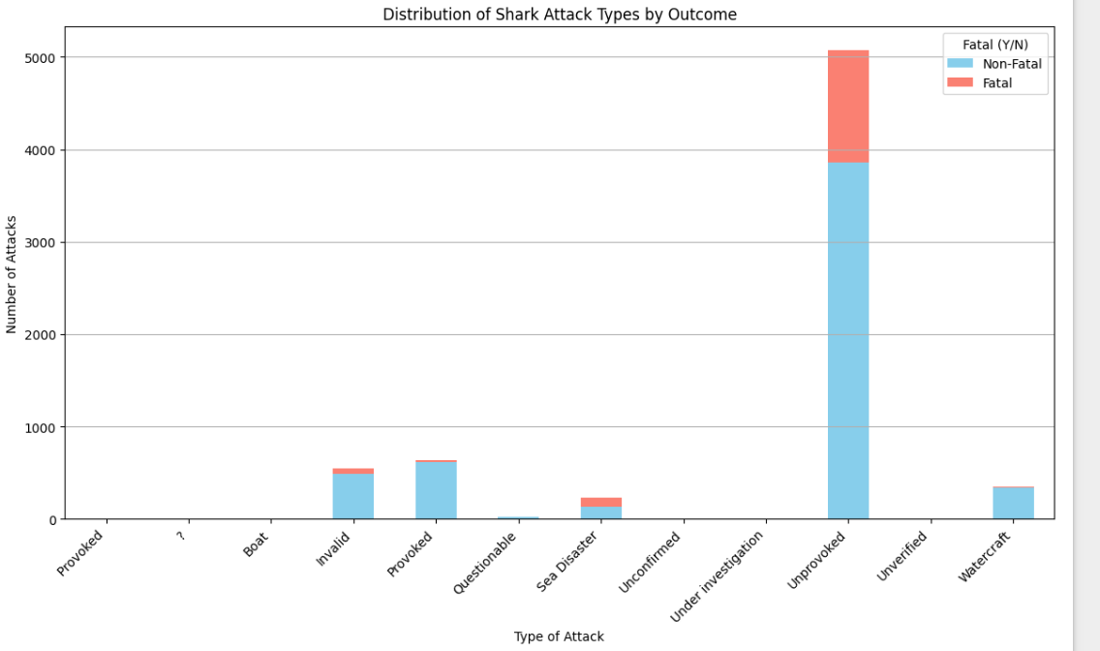
Hypothesis
Fatal or Non-Fatal:

Slide 9
Conclusion
Unprovoked Attacks: Represent the majority of recorded incidents, with a significant portion resulting in fatalities. This suggests that unprovoked attacks are not only the most common but also more likely to result in severe outcomes.
Provoked Attacks: While relatively high in number, provoked attacks have a much lower fatality rate, indicating that these incidents, despite being initiated by human interaction, tend to be less deadly.
Sea Disaster: This category, which involves attacks following maritime disasters, shows a relatively high fatality rate, likely due to the circumstances under which these attacks occur, such as shipwrecks or air crashes at sea.
Watercraft: Attacks associated with watercraft are predominantly non-fatal, suggesting that while sharks may interact with boats or other watercraft, these encounters rarely result in severe human injuries.
Invalid and Other Categories: Include incidents that were either not confirmed as shark attacks, had insufficient information, or were under investigation, with most being non-fatal

Slide 10
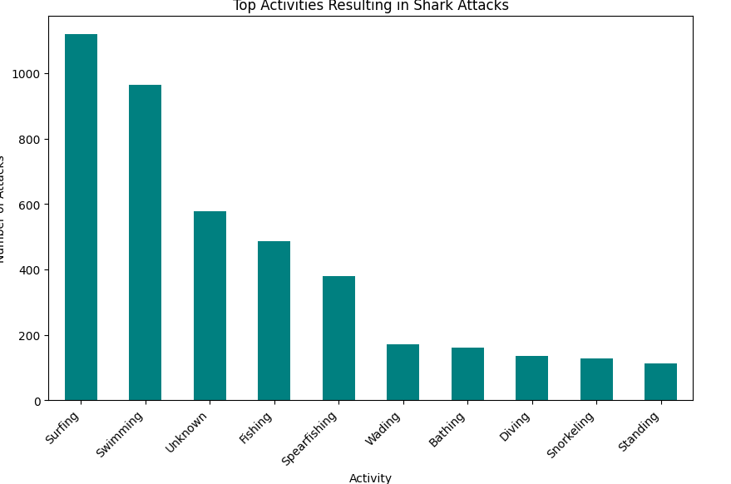
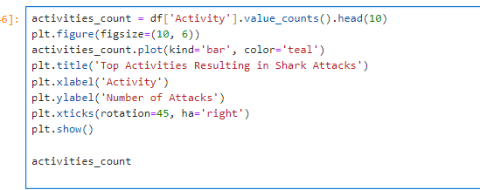
Most activities to encounter shark attacs
Surfing and swimming are the activities most commonly associated with shark attacks, which is not surprising given the nature of these activities putting humans into direct contact with the aquatic environment where sharks live.

Slide 11
Most countries with shark attacks

